Slide 1

Research Title: Personal
Finances Research Report
Analysis of financial patterns among 121 university student survey participants.
Submitted by:
Abdullah Bin Masood (SP23-BBD-004)
Maaz Ghazi (SP23-BBD-028)
Aleesha Malik (SP23-BBD-009)
Abdur Rehman (SP23-BBD-005)
Maryam Aslam (SP23-BBD-031)
Submitted to: Uzma Naeem
University: COMSATS University

Slide 2
Introduction
Study Overview
Research Variables
Our research examines the financial habits of university students, focusing on their ability to manage pocket money and make informed financial decisions.
It includes 121 responses, with data on “age, semester, gender, living status, pocket money range, and various spending categories like public transport, gasoline, rent, and mobile bills.
Understanding how students manage money independently provides valuable insights for effective financial education.
Spending Pocket Money.
Pocket money.
Living Status.
Budgeting Pocket Money

Slide 3

Problem Statement
Why there is a need for this research?
Most of the university students experience difficulties while managing their pocket money due to low financial education, low budgeting and not keeping a proper track of their spendings.
Student budgets often fall short well before the month ends, forcing them to take short-term measures to pay for their expenses. Personal factors like age, gender, semester and livelihood can influence a student's financial confidence and decision making.
For students, it is also important to understand these patterns and develop effective financial management strategies so they can identify the main difficulties in saving money.

Slide 4
Literature Review
Financial Literacy and Behavior
Education and Spending Patterns
Planning and Financial Stress
Financial literacy significantly influences saving behaviors, budgeting practices, and debt control mechanisms among students (Ansong, 2011).
Research by Zimmerman & Katon (2005) demonstrates that insufficient financial education often leads to impulsive spending behaviors and poor financial decision-making.
University students frequently experience financial stress and anxiety directly attributable to inadequate financial planning and management skills.
Women's Financial Behavior
Men's Financial Behavior
Academic Major Impact
Female students reported higher levels of financial anxiety and stress regarding their monetary decisions.
Male students demonstrated greater confidence in financial decision-making.
Business majors consistently showed higher financial literacy scores than their non-business counterparts.
This anxiety persisted despite careful financial planning behaviors (Hira & Mugenda, 2000).
However, they expressed more dissatisfaction with their savings rates and accumulation (Hira & Mugenda, 2000).
This advantage translates to more effective money management practices (Volpe et al., 1996).

Slide 5

THEORETICAL FRAMEWORK
Independent Variable
Pocket Money
Mediator
Budgeting Pocket Money
Dependent Variable
Spending Pocket Money
Moderator
Living status of student

Slide 6








HYPOTHESIS
H1: Pocket Money
H2: Spending Pocket Money
More pocket money leads to increased spending behaviors
Independent living results in higher overall spending
H4: Living Status of student
H3: Budgeting
Living status influences how budgeting affects spending
Regular budgeting practices improve spending control

Slide 7
Research Design
Type
Sample Size
Quantitative, descriptive, correlational
121 university students
Tool
Sampling
Questionnaire
Stratified random sampling
Analysis Tools
Techniques
Google Spread Sheets, Excel
Descriptive statistics, correlation, regression

Slide 8
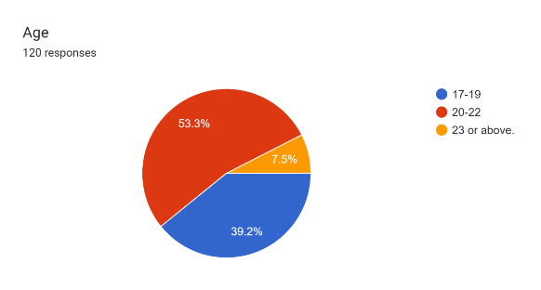
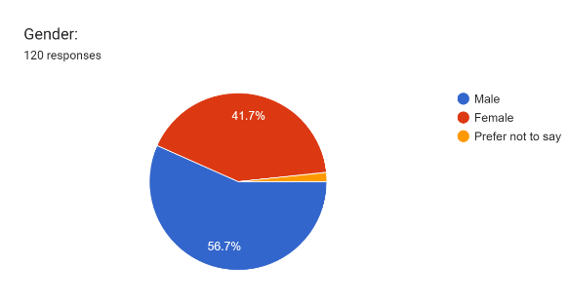
Results
Demographics
Profile of survey respondents (n=121)
Age Group:
20-22 → 64
17-19 → 47
23 or above→ 9
Gender:
Male → 68
Female→ 50
Prefer not to say → 2

Slide 9
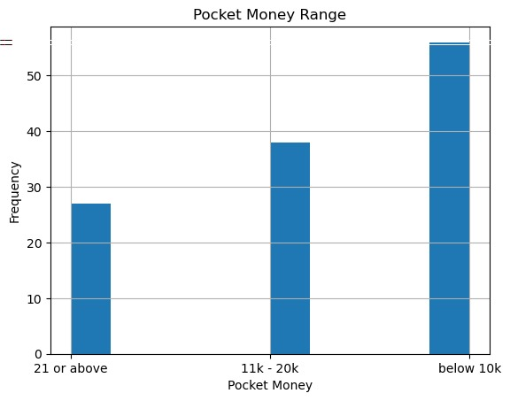
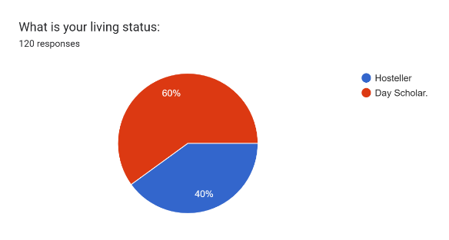
Results
Demographics
Pocket Money Range:
below 10 → 55
11k - 20k → 38
21 or above → 27
Profile of survey respondents (n=121)
Living Status:
Hosteller → 72
Day Scholar → 48

Slide 10

Conclusion
Financial Behavior Patterns
Students with more pocket money consistently demonstrate higher spending behaviors.
Financial Control Mechanisms
Regular budgeting and expense tracking significantly improve financial control and decision-making.
Living Situation Impact
Independent living introduces additional financial pressures, requiring stronger money management skills.
Savings Importance
Consistent saving habits correlate strongly with increased financial confidence and reduced stress.
These findings highlight the critical need for targeted financial education programs that address the unique challenges university students face.

Slide 11





Recommendations
Launch financial literacy workshops
Promote budgeting apps/tools
Provide financial counseling services
Provide regular sessions covering budgeting, saving, and responsible spending habits
Recommend user-friendly applications to help students track expenses and plan finances
Offer one-on-one guidance for students facing financial challenges or decisions
Encourage part-time work/internships
Customize allowances based on student needs
Create opportunities for students to gain work experience while earning income
Develop flexible financial support systems accounting for different living situations
Early financial education programs show strong correlation with healthier long-term financial habits and reduced stress among students.

